Slide 1
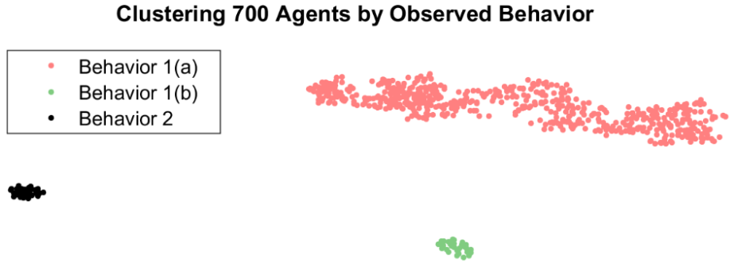
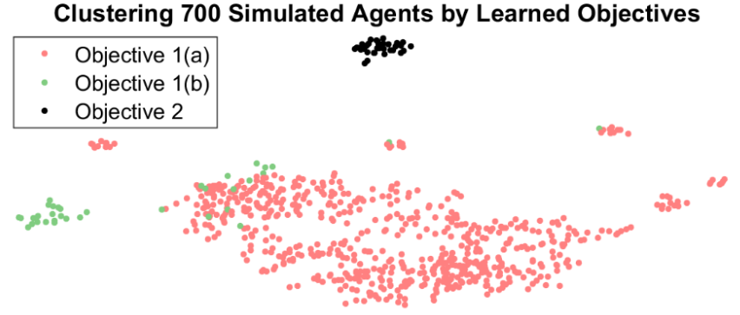
ABM Construction Using Inverse Reinforcement Learning
Prof. Matthew Gerber, Mark Rucker
University of Virginia
Project Start: 02/01/2017 | End Date: 6/30/2017 | Project Budget: |  | Spent:
Project Summary: Discovering underlying goals by observing behavior is a pressing challenge in many human problems. Recent advances in Inverse Reinforcement Learning algorithms combined with more traditional Reinforcement Learning techniques have begun to allow both correct identification of goals as well as recreation of behavior. Combining these techniques we show that accurate models can be created from data. These constructed digital models contain both individual behavior as well as aggregate emergent properties which are only observed in interactions with others. The hope is that this kind of modeling can open up new pathways in understanding human institutions and process such as attorneys, self represented litigants and courts. Understanding the goals that drive behavior at an individual level could lead to better digital assistance for litigants (prescriptive) as well as insight into why some legal cases result in positive outcomes while others don’t (descriptive). Using synthetic data, this project was able to show that the above goals are achievable and within reach given current state of the art algorithms. Next steps will include examining how to best use recovered rewards and constructed models to create interventions into a system that create desired outcomes. Furthermore, by providing insight into aggregate outcomes it allows for reasoning about causes and conditions at multiple levels, a powerful tool to understand complex sequential decision process. By accomplishing this in a digital format it also represents this knowledge in a way directly accessible to computational agents, a challenging feat in itself.
Details of Progress/Achievements: Competed and conference published paper, fully working algorithms and models, verified output for synthetic inputs
PROJECT DELIVERABLES
Deliverable |  |  | Achievements |  |  | Remaining To Do
1. Working implementation of inverse reinforcement learning projection algorithm |  |  | Fast, Accurate, Correct
2. Forward reinforcement learning algorithm to discover optimal policy |  |  | Fast, Accurate, Correct
3. Construction of agent-based model from data traces, IRL and RL algorithms |  |  | Accurate recreation of original aggregate outcomes
4. Identification of underlying goals behind observed behavior patterns |  |  | Correct clustering of all behavior by original goals
IRL

